Slide 1
Annual online store analysis
Presented by: Alyssa Gomez
Last updated: January 29th, 2024

Slide 2
Summary
This slideshow provides a comprehensive overview of key metrics including total counts of specific data groups, customer distributions, gender distributions, daily sales, revenue, purchase counts, coupon distribution, and the online and offline activity of customers. Dive into the data to uncover insights driving customer behavior and sales performance.

Slide 3
Table of contents
Specifications of the data
Total counts of specific groups of data
Customer distribution
Gender distribution
Daily sales
Daily revenue
Purchase counts
Coupon distribution
Online activity
Offline activity

Slide 4
Specifications of the dataset
The total number of buyers is 52955.
The total number of customers is 1468.
The number of different products is 1145 placed into 21 different categories.
The number of cities that held sales is 5.
The number of revenue is $27,64,625.

Slide 5
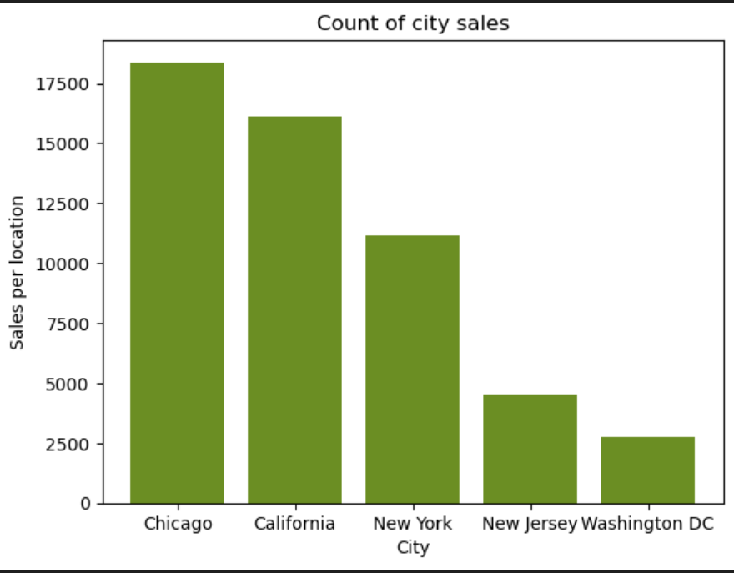
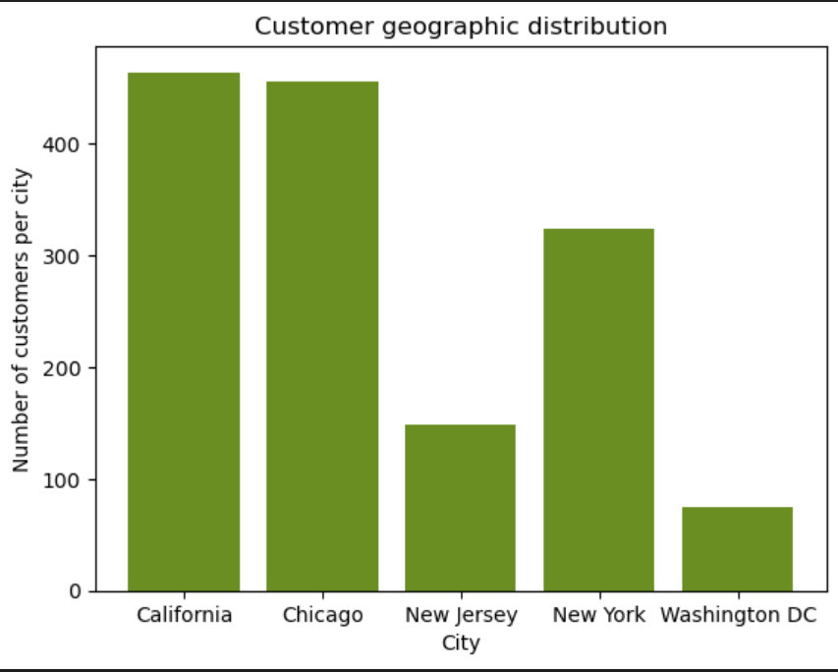
Where customers are distributed
This graph illustrates the distribution of customers across different locations.
This graph demonstrates the number of total sales in each location.

Slide 6
City buyer distribution
California - 16136
Chicago - 18380
New Jersey - 4503
New York - 11173
Washington DC - 2732
These numbers represents the total sales volume for each state.

Slide 7
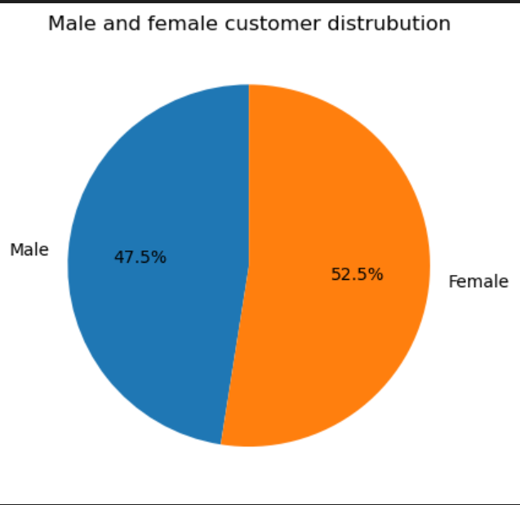
Gender distribution
This graph displays the distribution of male and female customers.
Males accounted for a total of 19,917 sales.
Female accounted for a total of 33,007 sales.

Slide 8
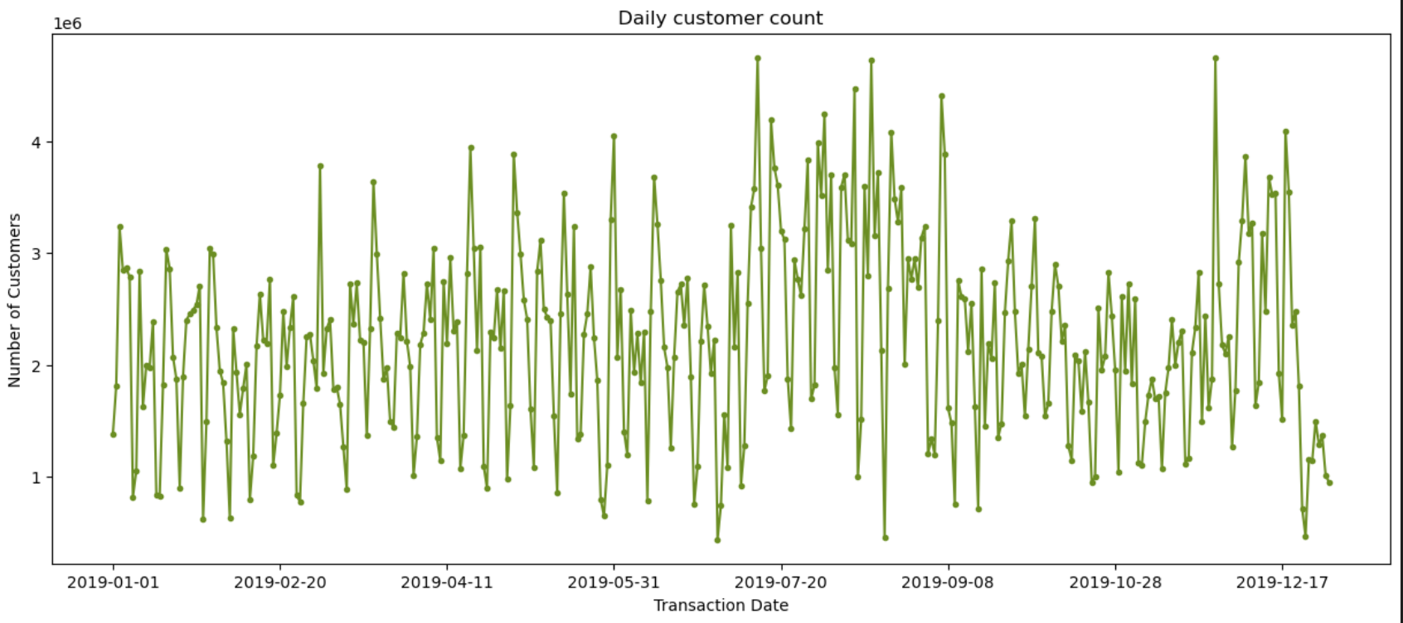
Customer distribution per day
This graph illustrates the daily sales pattern.

Slide 9
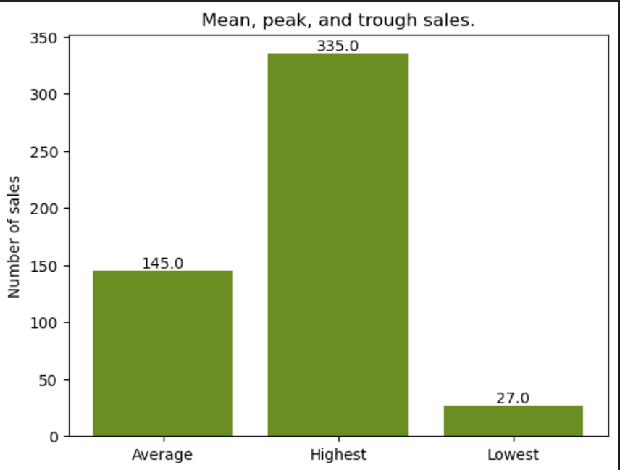
Daily revenue
The dates with the three lowest daily revenues are July 1st, 2019; August 20th, 2019; and December 24th, 2019, with corresponding customer counts of 27, 32, and 35 respectively
The dates associated with the three highest daily revenues are November 27th, 2019; July 13th, 2019; and August 16th, 2019, with corresponding customer counts of 335, 311, and 298 respectively.
This graph illustrates the average, maximum, and minimum number of sales per day.

Slide 10
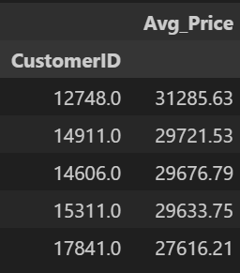
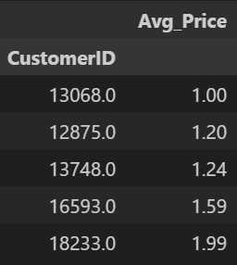
Highest and lowest customer purchase counts
These represent the top five highest and lowest number of purchases made by each customer, with the left graph being the five highest and the right graph being the five lowest
Highest
Lowest

Slide 11
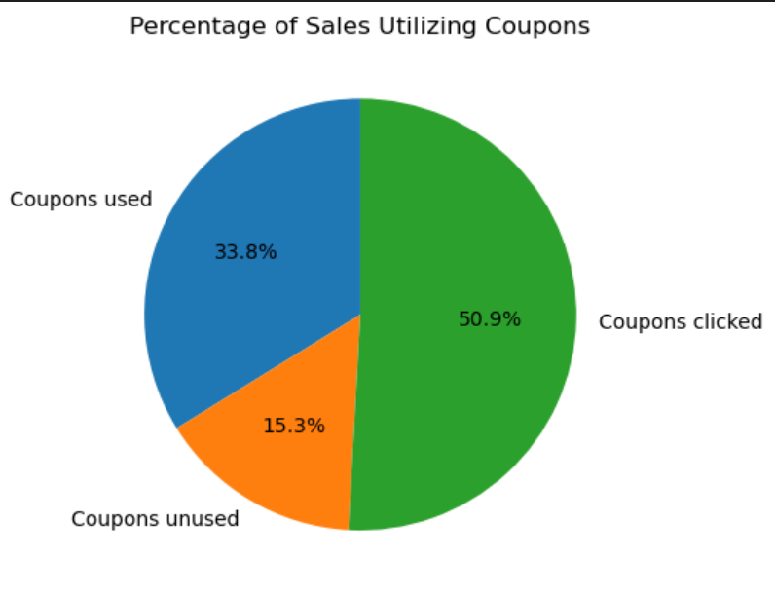
Coupons distributions
This graph illustrates the distribution of coupon usage as a percentage of total sales.
There are 48 different coupons used.

Slide 12
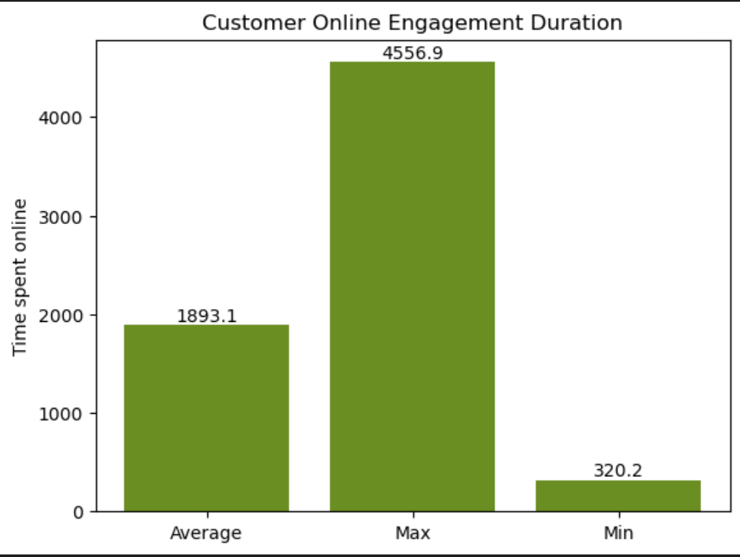
Online activity
This graph illustrates the average, maximum, and minimum durations of customer online activity

Slide 13
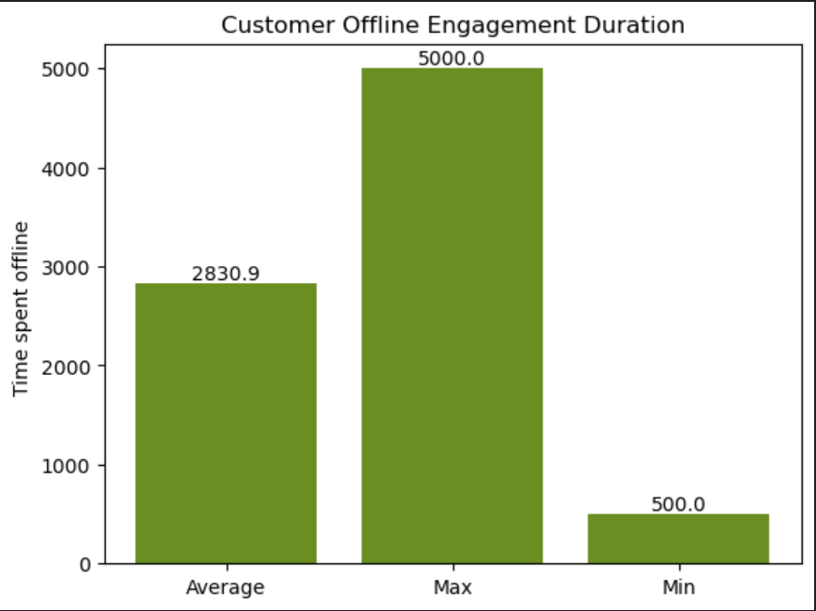
Offline activity
This graph illustrates the average, maximum, and minimum durations of customer offline activity

Slide 14
Conclusion
In conclusion, this in-depth analysis of these business metrics has offered valuable insights into various aspects of the company’s operations. From understanding customer distributions and gender demographics to tracking daily sales, revenue, and purchase counts, we've gained a holistic perspective on the company’s performance. The examination of coupon distribution and the online and offline activities of the customers has provided key indicators for strategic decision-making. Armed with this knowledge, the company is well-positioned to refine their approach, optimize customer engagement, and drive continued success in the ever-evolving landscape of the business.

